Slide 1
Introduction to SQL
Key Concepts:
SQL is an ANSI/ISO standard
Major DBMS vendors have their own version, which differ from each other in minor ways.
Microsoft's version is called T-SQL.
SQL is divided into 3 parts:
DML (Data Manipulation Language), DDL (Data Definition Language), DCL (Data Control Language)
A schema is a group of objects (tables, views, stored procedures) that logically belong together.
Good programming practice: End SQL statements with semi-colons.
Regular & Irregular Identifiers

Slide 2
SQL
SQL stands for Structured Query Language, a language for manipulating relational database tables.
Pronounced “Sequel” or S-Q-L.
American National Standards Institute (ANSI) prescribes a standard SQL.
Several SQL versions (or “dialects”) exist, usually with extensions to the standard version. Each manufacturer’s DBMS speaks its own dialect.
The versions are similar; most basic SQL statements are the same for all SQL versions.
Once you have learned one SQL version, you can easily learn other versions.
Microsoft SQL Server’s SQL version is called Transact-SQL (T-SQL).

Slide 3
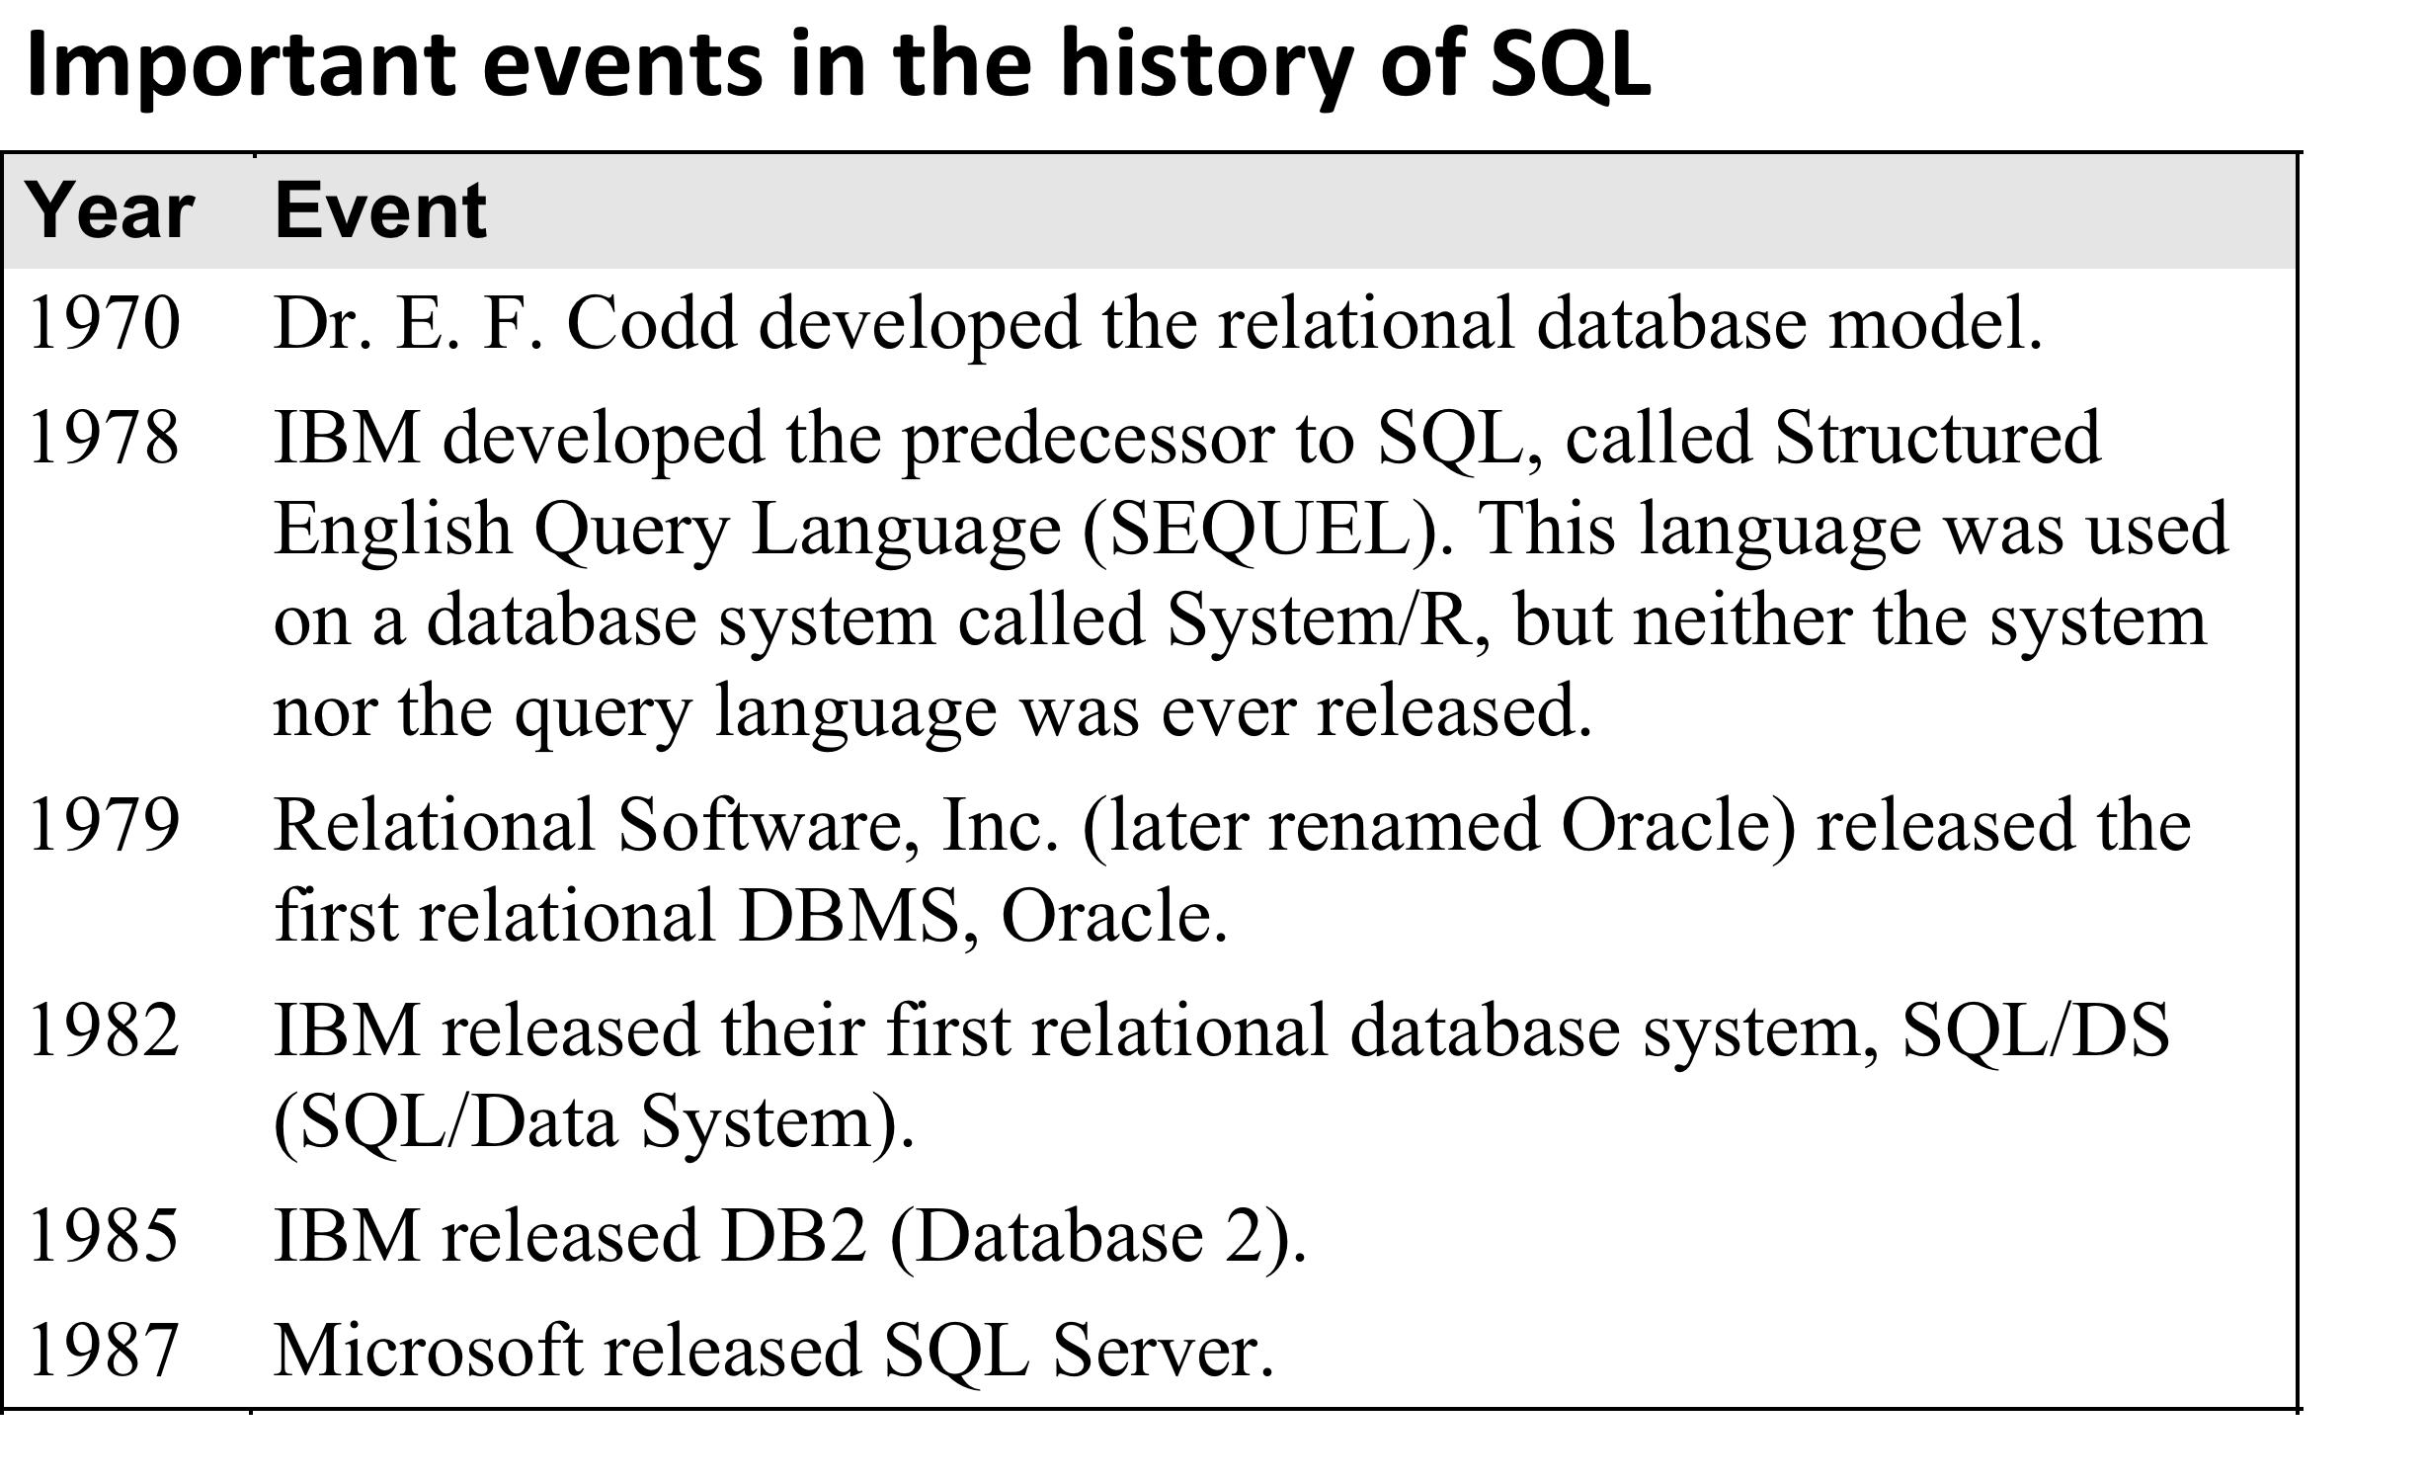

Slide 4
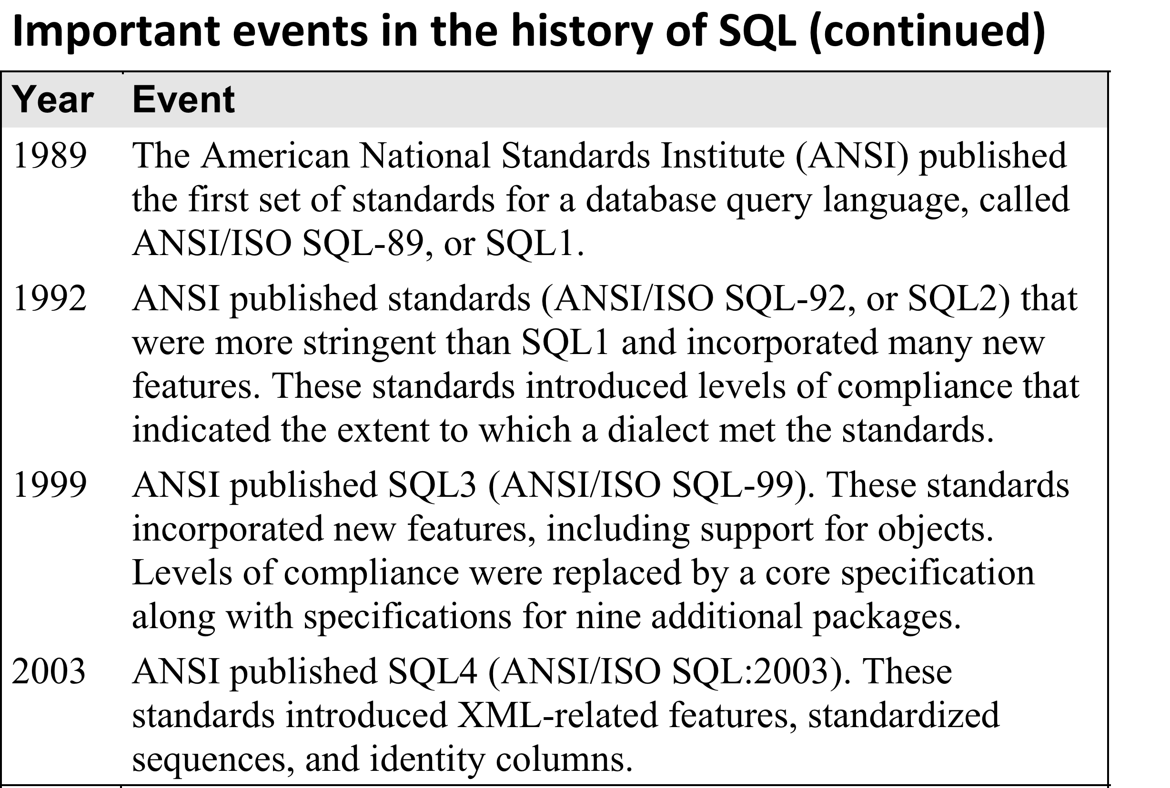
2011 Most recent version is SQL 7 (ANSI/ISO SQL:2011).

Slide 5
Components of SQL
SQL consists of 3 main parts:
Data Manipulation Language (DML)
Querying: Extracting data from tables.
Modification: Inserting, updating, deleting rows in existing tables.
Data Definition Language (DDL)
Defining new tables, dropping old ones.
Data Control Language (DCL)
Security & Access Control
Transaction Management
Performance
SQL is declarative, not procedural.
You specify what you want, not how to get it.

Slide 6
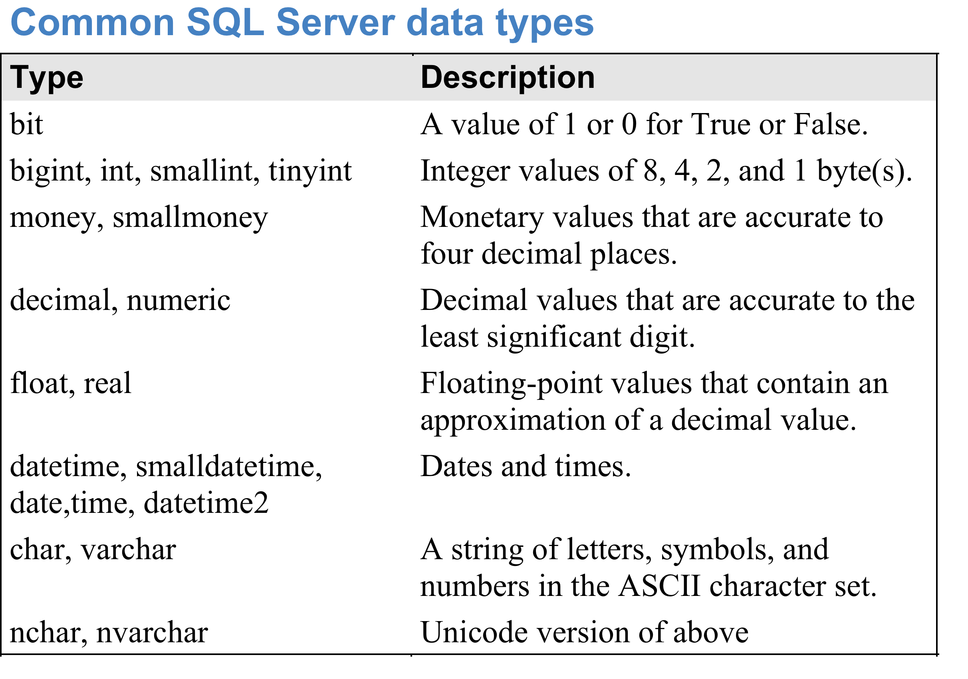
SQL Server Architecture
Schema
Object

Slide 7
Microsoft SQL Server
MS SQL Server terminology:
SQL Server Instance – a single installation of the SQL Server Database engine/service.
Can have multiple instances on the same computer.
The first one is known as the default instance, and has the same name as the computer name.
Later instances must be given their own names.
Each instance is independent in terms of security, data, etc.
May actually share some resources behind the scenes.
One server instance can have multiple databases.
Objects: tables, views, stored procedures, etc.

Slide 8
Schemas
MS SQL Server terminology:
Schema: A group of objects in a database.
One database can have multiple schemas. Usually you want to put tables that belong together into the same schema.
E.g. AdventureWorks is divided into the following schemas:
HumanResources, Person, Production, Sales
A user can be given permission to access a schema, thus giving them access to only part of a database.
Every database is automatically created in a schema called "dbo" (database owner).
You can create your own schemas by expanding the database, right-clicking on Security (make sure it's NOT the general Security folder!), and selecting New -> Schema.

Slide 9

Comments
Comments are indicated using either:
Double dash --
Comment extends to end of line.
E.g. Code here --This is a comment
OR
/* and */
Encloses a comment (possibly multi-line)
E.g. /* This is a long
long
comment. */
Comment out selected lines
Uncomment selected lines

Slide 10
Semi-colons
Although not always required, it is good programming practice to end all SQL statements with semi-colons.
Sometimes omitting the semi-colon will result in errors.

Slide 11
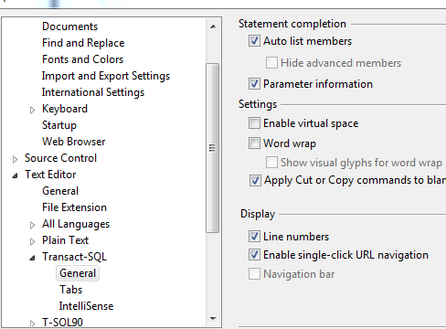
Line Numbers
Line-numbers are very useful (e.g. for error messages).
Tools ->
Options ->
Text Editor ->
Transact-SQL -> General ->
check the Line Numbers box under Display on the right.

Slide 12
Identifiers
Regular identifiers (variable or function names) must:
Begin with a letter or underscore.
Each subsequent character must be a letter, number, "at" sign (@), dollar sign ($), number sign (#), or underscore.
Not be a reserved word.
See http://technet.microsoft.com/en-us/library/ms189822.aspx for the complete list.
It is also allowed to make irregular identifiers, which violate the above rules, but they must be enclosed in square brackets or double-quotes.
E.g. [order details] irregular - contains a space
E.g. "3rdNormalForm" irregular – starts with a number
Regular identifiers may be enclosed in in square brackets or double-quotes.

Slide 13
Case-Sensitivity & Collations
SQL keywords and identifiers are NOT case-sensitive.
E.g. OrderDetails, orderdetails, orderDetails are all the same variable.
However table and column names may be case-sensitive, depending on the database's collation settings.
To see the collation settings, right-click on the database, select Properties -> Options.

